Slide 1

Department of Computer Science & Engineering
IMAGE CAPTION AND SPEECH GENERATION
USING LSTM AND GTTS API
Date: 29 May 2021
S.POOJA SAI SREE : 17WH1A0549
D.MANISHA : 17WH1A0524
S.SUSMITHA : 17WH1A0529
Internal Guide: Mr. K. BHARGAV RAM
Designation: Assistant Professor
BVRIT HYDERABAD College of Engineering for Women

Slide 2

ABSTRACT
Why Should I Study this course?
Problem statement
Flickr 8k dataset consists of images, where each of them is paired with five different captions which provide clear descriptions of the salient entities and events. The task is to generate relatable caption/description and audio for a given image.
Project Objective
This project aims to develop Image caption and speech generator, a tool which generates captions or descriptions for an image according to the content observed. It also generates audio/speech for the description obtained. This can be done using Deep learning algorithms such as VGG16 model (CNN based), Long Short-Term Memory(Recurrent Neural Network) for generating captions and GTTS (Google Text To Speech) API for obtaining speech from description.
Examples
BVRIT HYDERABAD College of Engineering for Women

Slide 3
DATASET
Why Should I Study this course?
Dataset Description
Flickr 8k dataset consists of two main types of data.
Image/Photo data - It has a total of 8091 images.
i) Training set - 6091 images
ii) Validation set - 1000 images
iii) Test set - 1000 images
2. Text data - It consists of list of descriptions for each image.
Examples
BVRIT HYDERABAD College of Engineering for Women

Slide 4
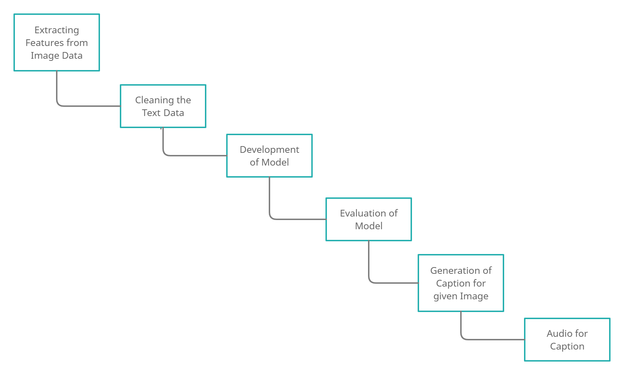
ARCHITECTURE
Why Should I Study this course?
Examples
BVRIT HYDERABAD College of Engineering for Women

Slide 5
EVALUATION METRIC
Why Should I Study this course?
BLEU SCORE :
BLEU (Bilingual Evaluation Understudy) is an evaluation metric for evaluating the quality of text and also used for comparing a candidate translation of text to one or more reference translations.
Bleu score ranges from 0 to 1
if score = 1, it is a perfect match result.
if score = 0, it is not a perfect match result
It is a corpus-based metric and modified version of precision metric.
Advantages of Bleu score:
It correlates highly with human evaluation.
It is language independent.
It is quick and inexpensive to calculate.
It is easy to understand.
Examples
BVRIT HYDERABAD College of Engineering for Women

Slide 6
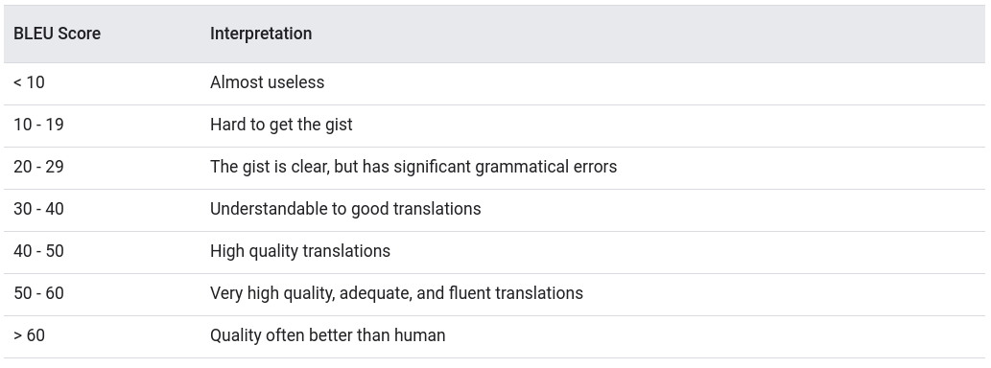
BLEU SCORE INTERPRETATION
Why Should I Study this course?
Ranges in Bleu Score
Examples
BVRIT HYDERABAD College of Engineering for Women

Slide 7
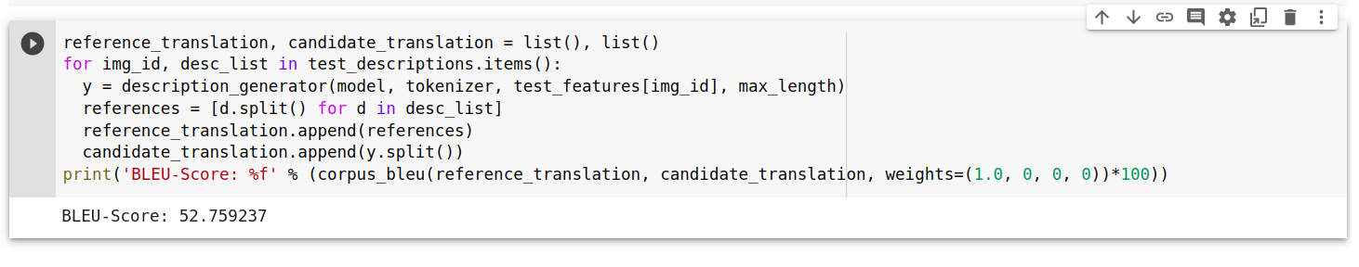
MODEL EVALUATION
Why Should I Study this course?
Examples
BVRIT HYDERABAD College of Engineering for Women

Slide 8
TECHNOLOGY STACK
Why Should I Study this course?
Python Language
VGG 16 (Virtual Geometry Group model with 16 layers) - CNN based Architecture
LSTM (Long Short-Term Memory) - RNN based Architecture
GTTS API
Examples
BVRIT HYDERABAD College of Engineering for Women

Slide 9
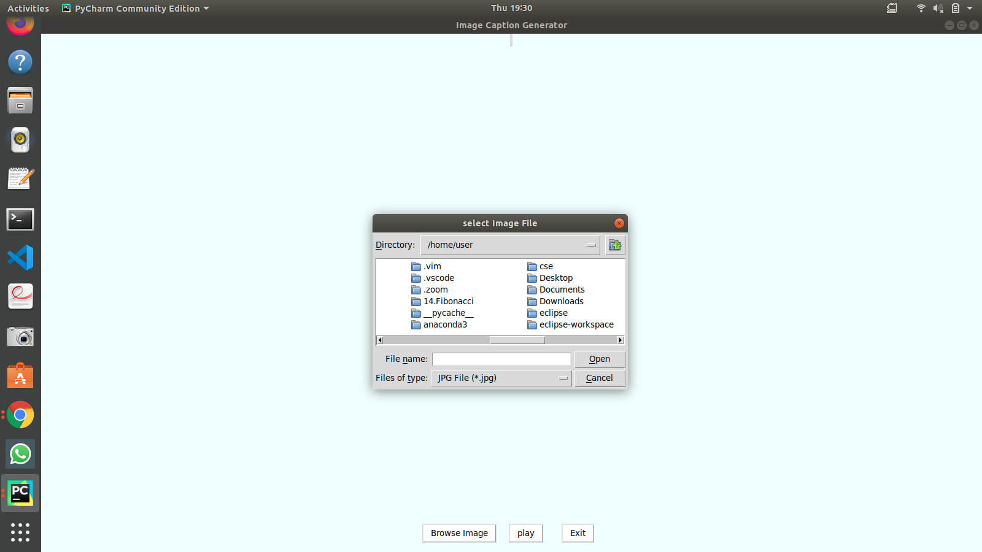
INPUT SCENARIO
Why Should I Study this course?
Examples
BVRIT HYDERABAD College of Engineering for Women

Slide 10
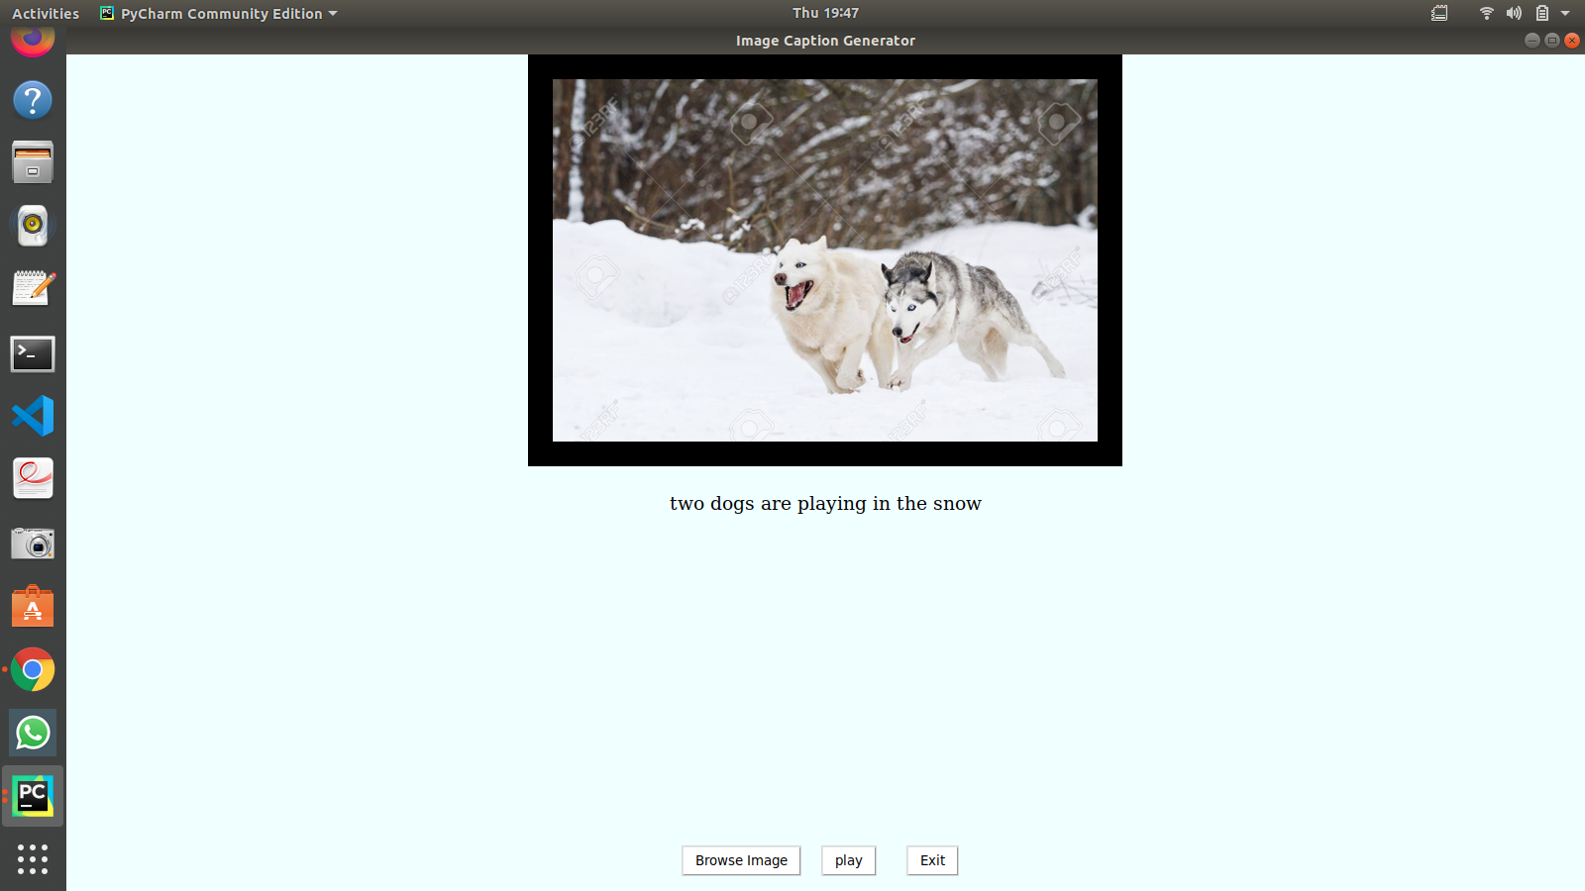
DESCRIPTION GENERATION
Why Should I Study this course?
Examples
BVRIT HYDERABAD College of Engineering for Women

Slide 11

SPEECH GENERATION
Why Should I Study this course?
Examples
BVRIT HYDERABAD College of Engineering for Women

Slide 12
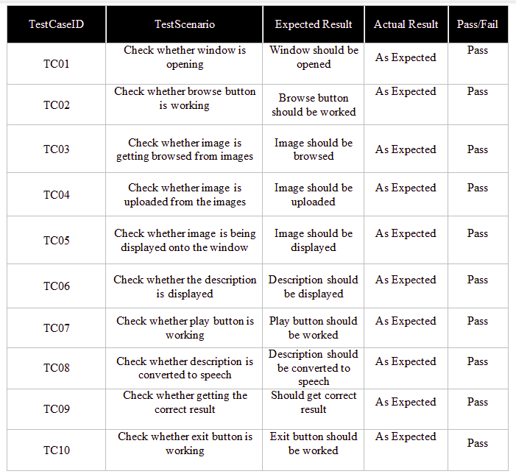
TEST CASES
Why Should I Study this course?
Examples
BVRIT HYDERABAD College of Engineering for Women

Slide 13
Thankyou
BVRIT HYDERABAD College of Engineering for Women

